Slide 1

503106
ADVANCED WEB PROGRAMMING
CHAPTER 2: Middleware
LESSON 06 – Middleware

Slide 2
Content
Middleware
Middlewares example
Third-party Middleware
Express application generator

Slide 3
Middleware
We’ve used existing middleware (body-parser, cookie-parser, static, and connect-session), and we’ve even written some of our own
Middleware is simply a function that takes three arguments: a request object, a response object, and a “next” function
Middleware is executed in what’s known as a pipeline. (order matters)
In an Express app, you insert middleware into the pipeline by calling app.use.
Where should we add “404 error middleware”?

Slide 4
Middleware
How is a request “terminated” in the pipeline? When you don’t call next()

Slide 5
Middleware and route handlers
Route handlers (app.get, app.post, etc.—often referred to collectively as app.VERB) can be thought of as middleware that handle only a specific HTTP verb (GET, POST, etc.).
Conversely, middleware can be thought of as a route handler that handles all HTTP verbs (this is essentially equivalent to app.all, which handles any HTTP verb)
Route handlers require a path as their first parameter.
Route handlers and middleware take a callback function
If you don’t call next(), the pipeline will be terminated, and no more route handlers or middleware will be processed.
If you do call next(), middleware or route handlers further down the pipeline will be executed, but any client responses they send will be ignored.
Notes:
1. If you don’t call next(), the pipeline will be terminated, and no more route handlers or middleware will be processed. If you don’t call next(), you should send a re‐ sponse to the client (res.send, res.json, res.render, etc.); if you don’t, the client will hang and eventually time out.
2. If you do call next(), it’s generally inadvisable to send a response to the client. If you do, middleware or route handlers further down the pipeline will be executed, but any client responses they send will be ignored.

Slide 6
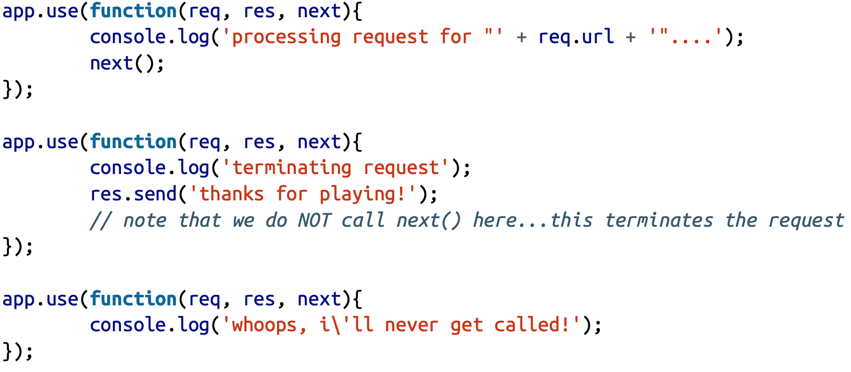
Middlewares example

Slide 7
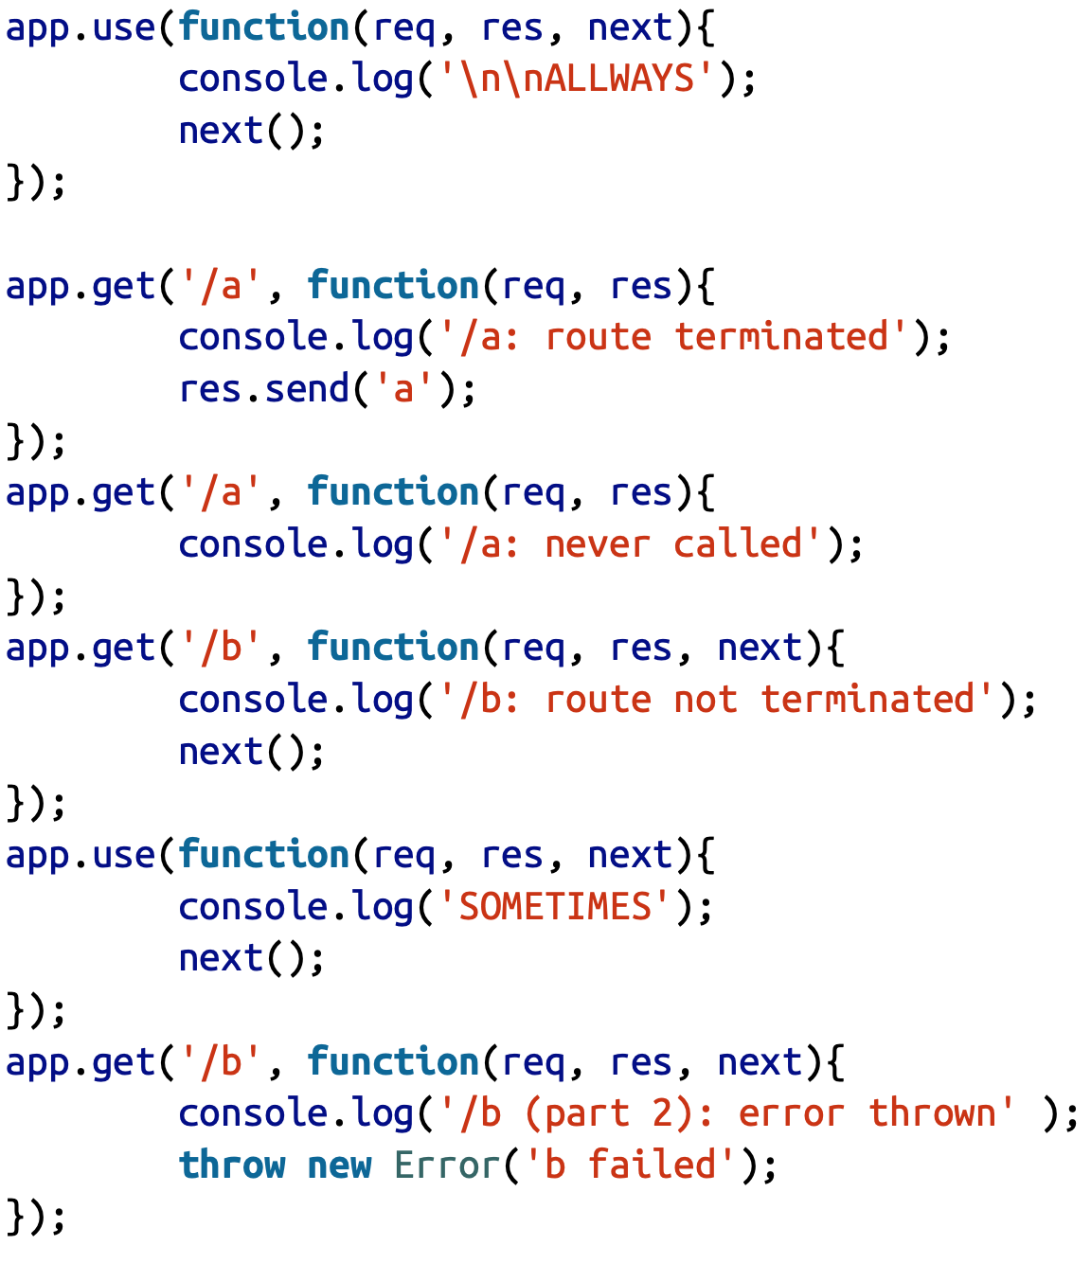
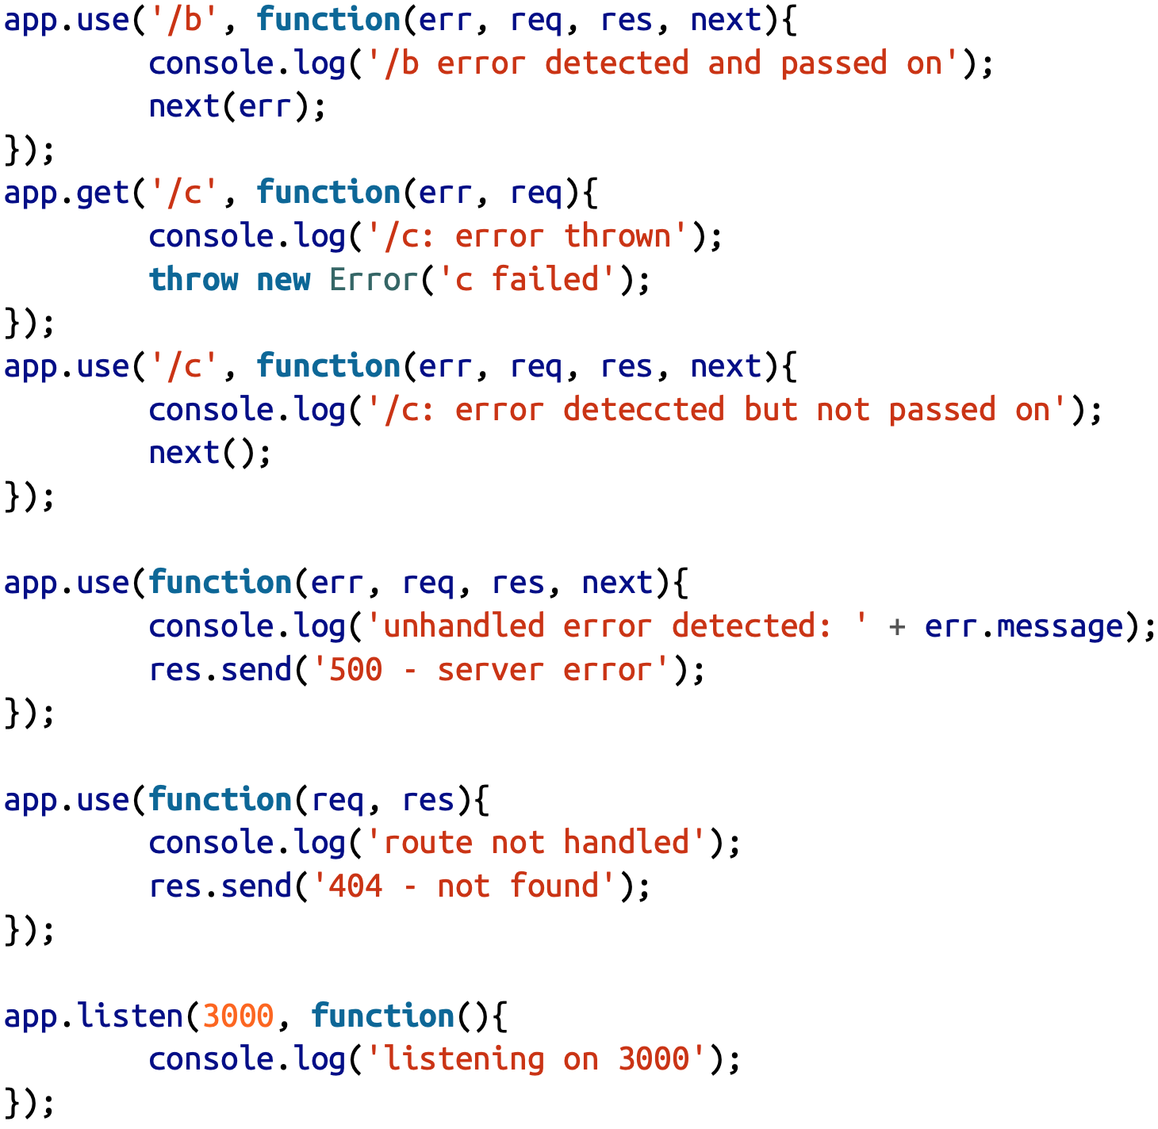
Middlewares example

Slide 8
Third-party Middleware
Use third-party middleware to add functionality to Express apps.
Install the Node.js module for the required functionality, then load it in your app at the application level or at the router level.
The following example illustrates installing and loading the cookie-parsing middleware function cookie-parser.
$ npm install cookie-parser
var express = require('express');
var app = express();
var cookieParser = require('cookie-parser');
// load the cookie-parsing middleware
app.use(cookieParser());
For a partial list of third-party middleware functions that are commonly used with Express, see: Third-party middleware.

Slide 9
Express application generator
Follow instructions from http://expressjs.com/en/starter/generator.html
Use the application generator tool, express-generator, to quickly create an application skeleton.
Install express-generator in myapp directory:
npm install express-generator -g
Display the command options with the –h option:
express -h
Create an Express app named firstApplication in the current working directory:
express firstApplication
Then, install dependencies:
cd firstApplication
npm install
set DEBUG=firstApplication:* & npm start
Then load http://localhost:3000/ in your browser to access the app.

Slide 10
Node.js - Streams
What are Streams?
Streams are objects that let you read data from a source or write data to destination in continuous fashion.
In Node, there are four types of streams:
Readable: stream which is used for read operation.
Writable: stream which is used for write operation.
Duplex: stream which can be used for both read and write operation.
Transform: a type of duplex stream where the output is computed based on input.

Slide 11
Streams and EventEmitter
Each type of stream from previous page is an EventEmitter and throws several events at times.
For example, some of the commonly used events are:
data: This event is fired when there is data is available to read.
end: This event is fired when there is no more data to read.
error: This event is fired when there is any error receiving or writing data.
finish: This event is fired when all data has been flushed to underlying system.

Slide 12
Streams samples
Reading from stream: wk3_01_reading_stream.js
Writing to stream: wk3_02_writing_stream.js
Piping streams: Piping is a mechanism to connect output of one stream to another stream. It is normally used to get data from one stream and to pass output of that stream to another stream. Consider the above example, where we have read the input file using readStream and write to an output file using writeStream. Now we will use the piping to simplify our operation or reading from one file and writing to another file. (wk3_03_piping_stream.js)

Slide 13
Read and Write
var fs = require('fs');
var my_data = '';
// create a readable stream
var readerStream = fs.createReadStream('./hw1_test.txt');
// set the encoding to be utf8
readerStream.setEncoding('UTF8');
// handle stream events - data, end, error events.
readerStream.on('data', function(chunk) {
my_data += chunk;
});
readerStream.on('end', function() {
console.log(my_data);
});
readerStream.on('error', function(err) {
console.log(err.stack);
});
console.log('Program Ended.');
var fs = require('fs');
var my_data = 'Output to a file\nHello World.';
// create a writable stream
var writeStream = fs.createWriteStream('./wk3_02_output.txt');
// write the data to stream
// set the encoding to be utf8
writeStream.write(my_data, 'UTF8');
// mark the end of file
writeStream.end();
// handle stream events - finish, error events.
writeStream.on('finish', function(chunk) {
console.log('write completed.');
});
writeStream.on('error', function(err) {
console.log(err.stack);
});
console.log('Program Ended.');

Slide 14
Piping stream
var fs = require('fs');
// create a readable stream
var readerStream = fs.createReadStream('./hw1_test.txt');
// create a writable stream
var writeStream = fs.createWriteStream('./wk3_03_output.txt');
// pipe the read and write operations
// read hw1_test.txt and write data to wk3_03_output.txt
readerStream.pipe(writeStream);
console.log('Program Ended.');

Slide 15
Node.js – File System
fs module is used for File I/O.
fs module can be imported using following syntax:
var fs = require('fs');
Synchronous vs Asynchronous [wk3_04_sync_async_read.js]
Every method in fs module have synchronous as well as asynchronous form. Asynchronous methods [readFile()] takes a last parameter [function (err, p2)] as completion function callback and first parameter of the callback function is error. It is preferred to use asynchronous method instead of synchronous method as former is non-blocking where later is blocking process.
fs.readFile('test.txt', function(err, data) {
});

Slide 16
Flags
Flag | Description
r | Open file for reading. An exception occurs if the file does not exist.
r+ | Open file for reading and writing. An exception occurs if the file does not exist.
w | Open file for writing. The file is created ifitdoesnotexist or truncated ifitexists.
w+ | Open file for reading and writing. The file is created ifitdoesnotexist or truncated ifitexists.
a | Open file for appending. The file is created if it does not exist.
a+ | Open file for reading and appending. The file is created if it does not exist.

Slide 17
Node.js – File System Methods
fs method | Description
fs.close(fd, callback) | Asynchronous close. No arguments other than a possible exception are given to the completion callback
fs.ftruncate(fd, len, callback) | Asynchronous ftruncate (remove data from the file).
fs.mkdir(path [, mode], callback) | Asynchronous mkdir. Mode defaults to 0777.
fs.open(path, flags [,mode], callback) | Asynchronous file open.
fs.rmdir(path, callback) | Asynchronous rmdir.
fs.stat(path, callback) | Asynchronous stat. The callback gets two arguments err, stats where stats is a fs.stats object.
fs.unlink(path, callback) | Asynchronous unlink (physically remove a file).
fs.write(fd, buffer, offset, length, position, callback) | Write buffer to the file specified by fd. Note: buffer can be Buffer or String; offset and length determine the part of the buffer to be written; position refers to the offset from the beginning of the file where this data should be written.

Slide 18
Node.js – File System sample
Please refer to wk3_05_fs.js

Slide 19
Node.js Modules
Module name | Description
buffer | buffer module can be used to create Buffer class.
console | console module is used to print information on stdout and stderr.
dns | dns module is used to do actual DNS lookup and underlying o/s name resolution functionalities.
domain | domain module provides way to handle multiple different I/O operations as a single group.
fs | fs module is used for File I/O.
net | net module provides servers and clients as streams. Acts as a network wrapper.
os | os module provides basic o/s related utility functions.
path | path module provides utilities for handling and transforming file paths.
process | process module is used to get information on current process.

Slide 20
Node.js – console module
console is a global object and is used to print to stdout and stderr.
Method | Description
console.log([data][, …]) | Prints to stdout with newline. This function can take multiple arguments in a printf-like way.
console.info([data][,…]) | Prints to stdout with newline. (support printf-like way).
console.error([data][,…]) | Prints to stderr with newline. (support printf-like way).
console.warn([data][,…]) | Prints to stderr with newine. (support printf-like way).
console.time(label) | Make a timer.
console.timeEnd(label) | Finish timer. Record output.

Slide 21
Node.js – process module
process is a global object and is used to represent Node process.
Exit Codes: Node normally exit with a 0 status code when no more async operations are pending. There are other exit codes:
Code | Name | Description
1 | Uncaught Fatal Exception | There was an uncaught exception, and it was not handled by a domain or an uncaughtException event handler.
2 | Unused | Reserved by Bash.
3 | Internal JavaScript Parse Error | The JavaScript source code internal in Node’s bootstrapping process caused a parse error.
…
>128 | Signal Exits | If Node receives a fatal signal such as SIGKILL or SIGHUP, then its exit code will be 128 plus the value of the signal code.

Slide 22
Node.js – process events
process is an eventEmitter and it emits the following events.
Event | Description
exit | Emitted when the process is about to exit.
beforeExit | This event is emitted when node empties it’s event loop and has nothing else to schedule.
uncaughtException | Emitted when an exception bubbles all the way back to the event loop.
Signal Events | Emitted when the processes receives a signal such as SIGNT, SIGHUP, etc.

Slide 23
Node.js – process properties
process provides many useful properties to get better control over system interactions.
Property | Description
stdout | A Writable Stream to stdout.
stderr | A Writable Stream to stderr.
stdin | A Writable Stream to stdin.
argv | An array containing the command line arguments.
execPath | This is the absolute pathname of the executable that started the process.
env | An object containing the user environment.
exitCode | A number which will be the process exit code.
version | A compiled-in property that exposes NODE-VERSION.
platform | What platform you are running on.

Slide 24
Node.js – process methods
process provides many useful methods to get better control over system interactions.
Method | Description
abort() | This causes node to emit an abort. This will cause node to exit and generate a core file.
chdir(dir) | Changes the current working directory of the process or throws an exception if that fails.
cwd() | Returns the current working directory of the process.
exit(code) | Ends the process with the specified code. If omitted, exit uses the “success” cdoe 0.
uptime() | Number of seconds Node has been running.

Slide 25
Node.js – os module
os module is used for few basic operating-system related utility functions.
os module can be imported using:
var os = require('os');
Method | Description
os.tmpdir() | Returns the O/S default directory for temp files.
os.hostname | Returns the hostname of the O/S.
os.type() | Returns the O/S name.
os.platform() | Returns the O/S platform.
os.arch() | Returns the O/S CPU architecture. Possible values are x64, arm, and ia32.
os.release() | Returns the O/S release.
os.totalmem() | Returns the total amount of system memory in bytes.
os.freemem() | Returns the amount of free system memory in bytes.
os.networkinterfaces() | Get a list of network interfaces.

Slide 26
Node.js – os property
Property | Description
os.EOL | A constant defining the appropriate End-of-line marker for the operating system.

Slide 27
Node.js – net module
net module is used to create both servers and clients. It provides an asynchronous network wrapper. net module can be imported using:
var net = require("net");
Method | Description
net.createServer([options][, connectionListener]) | Creates a new TCP server. The connectionListener argument is aumatically set as a listener for the ‘connection’ event.
net.connect(port[, host][, connectionListener]) | Creates a TCP connection to port on host. If host is omitted, ‘localhost’ will be assumed. The connectionListener parameter will be added as an listener for the ‘connect’ event. It is a factory method which returns a new ‘net.Socket’.
net.createConnection(port[, host][, connectionListener]) | Creates a TCP connection to port on host. If host is omitted, ‘localhost’ will be assumed. The connectionListener parameter will be added as an listener for the ‘connect’ event. It is a factory method which returns a new ‘net.Socket’.

Slide 28
Node.js – net.Server class
net.Server class is used to create a TCP or local server. (wk3_09_02_net_server.js)
var net = require('net');
var server = net.createServer(function (socket) {
socket.end('Socket End.');
});
Method | Description
server.listen(port[, host][, callback] | Begin accepting connections on the specified port and host. A port value of zero will assign a random port.
server.close(callback) | Finally closed when all connections are ended and the server emits a ‘close’ event.
server.address() | Returns the bound address, the address family name and port of the server as reported by the operating system.

Slide 29
Node.js – other modules
path module is used for handling and transforming file paths. Path module can be imported using:
var path = require("path");
dns module is used to do actual DNS lookup as well as to use underlying operating system name resolution functionalities.
var dns = require("dns");
domain module is used to intercept unhandled error.
var domain = require("domain");

Slide 30
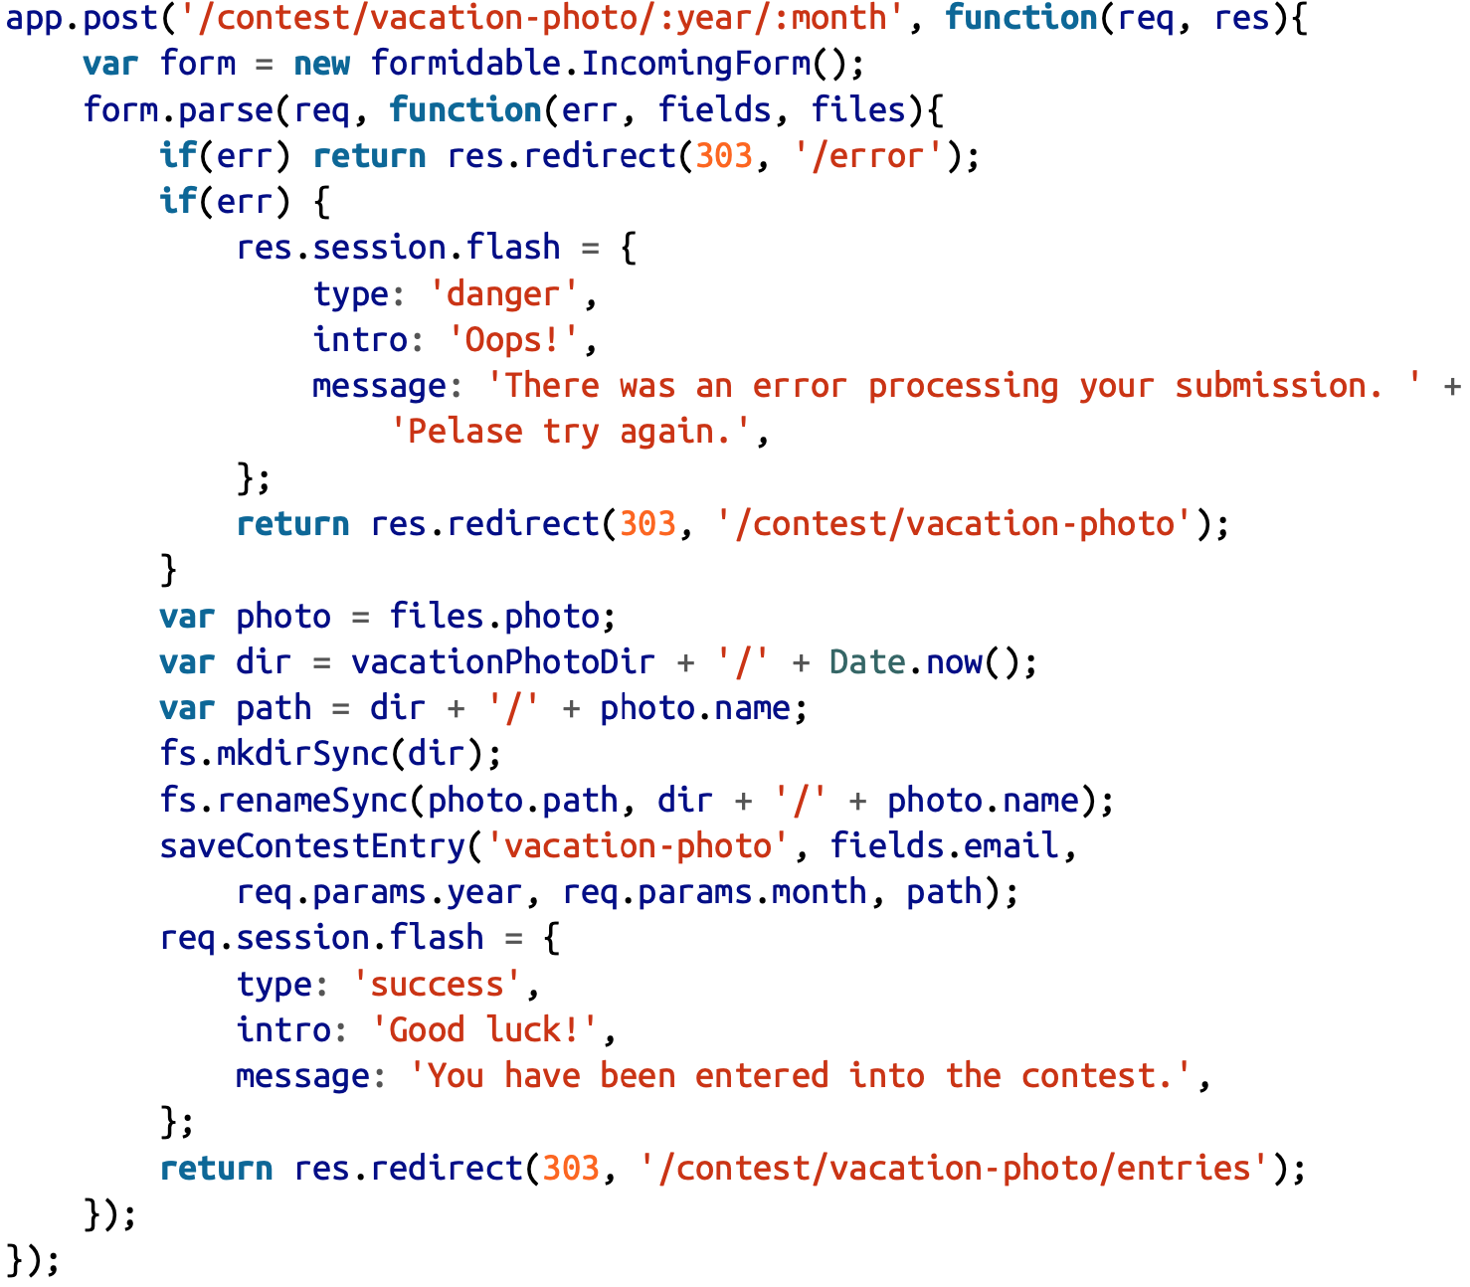
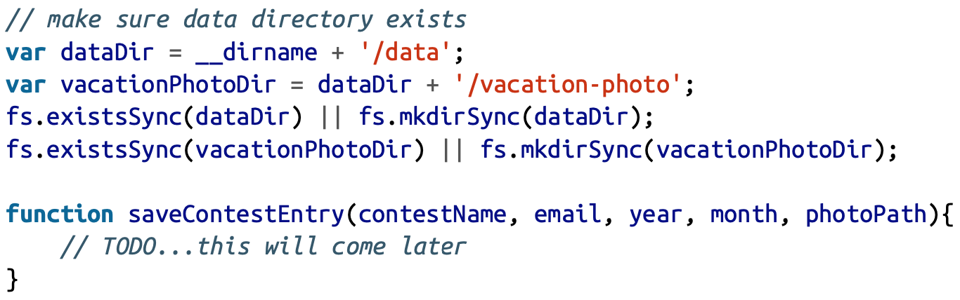
Upload file

Slide 31
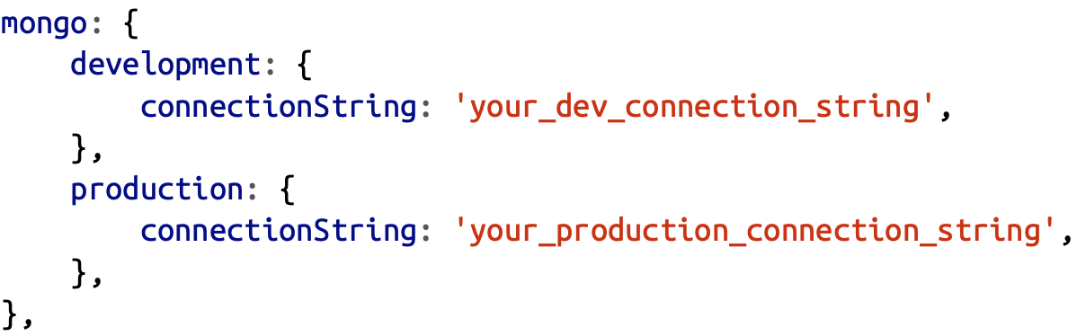
Database Persistence
We use MongoDB to save data
Before we get started, we’ll need to install the Mongoose module:
npm install --save mongoose
Then we’ll add our database credentials to the credentials.js file:

Slide 32
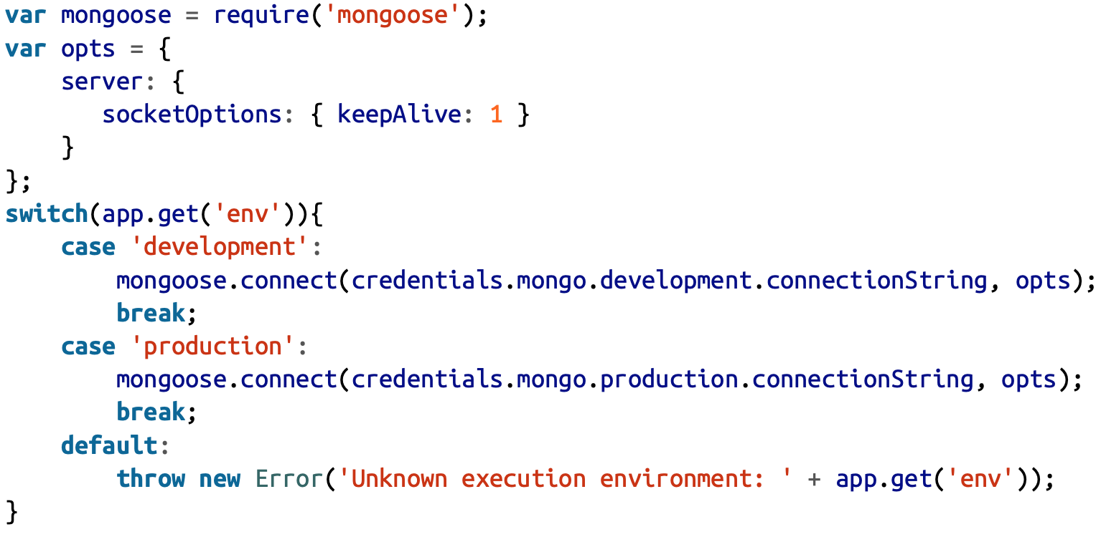
Database Connections with Mongoose

Slide 33
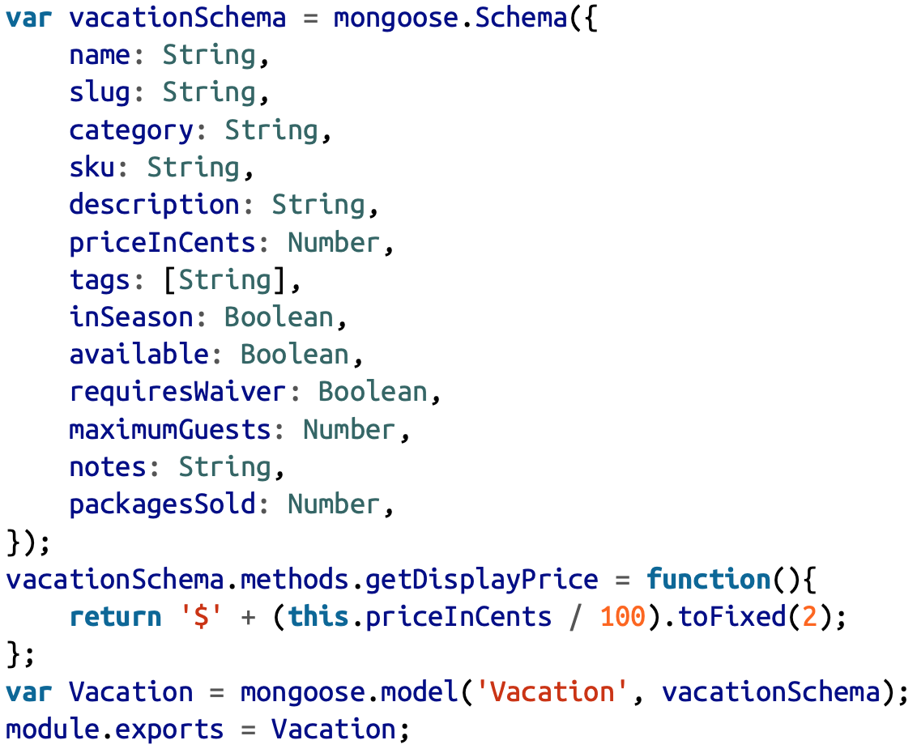
Creating Schemas and Models
To work with Mongo we need to define models
Example: models/vacation.js

Slide 34
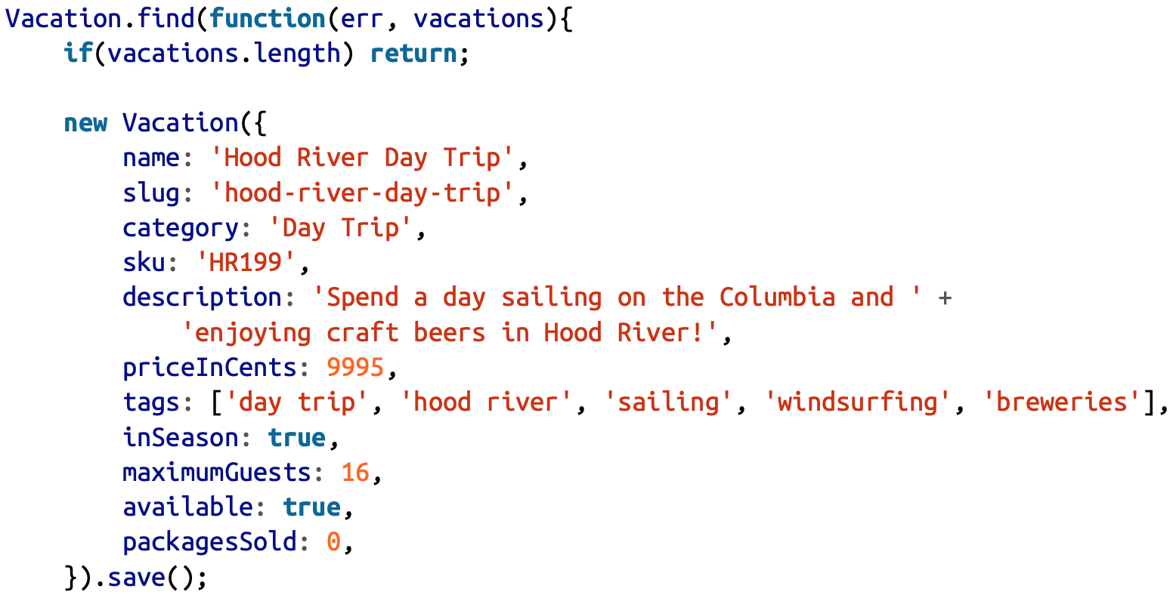
Seeding Initial Data
var Vacation = require('./models/vacation.js');

Slide 35
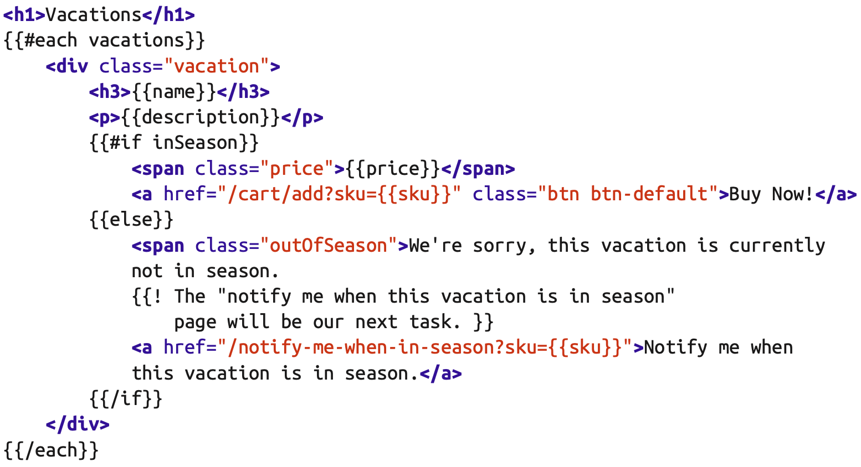
Retrieving Data
To display only vacations that are currently available create a view for the vacations page, views/vacations.handlebars:

Slide 36
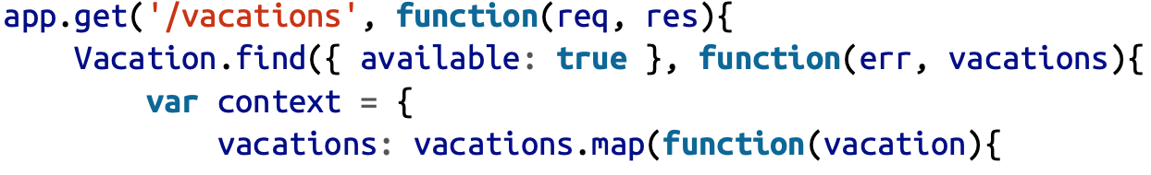
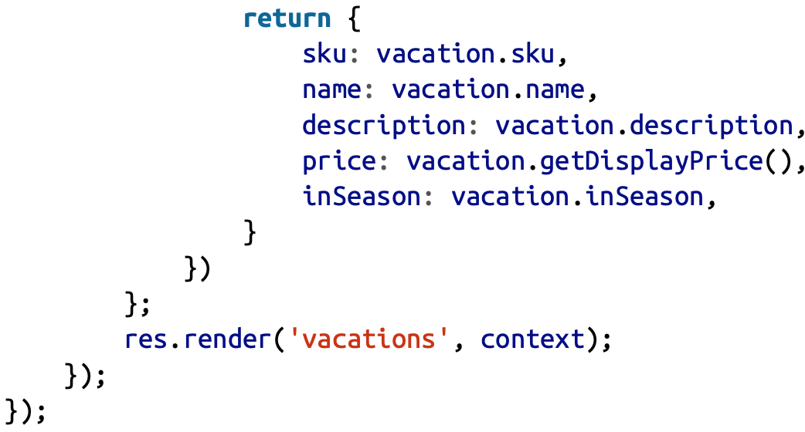
Retrieving Data
Now we can create route handlers that hook it all up:

Slide 37
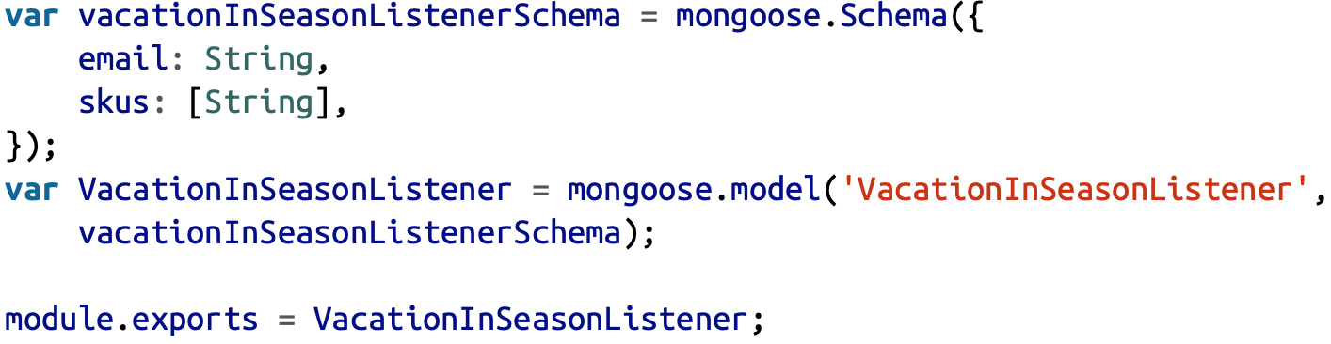
Adding Data
Create model object and call save method
To update data, let check other example: we create the schema and model (models/vacationInSeasonListener.js):

Slide 38
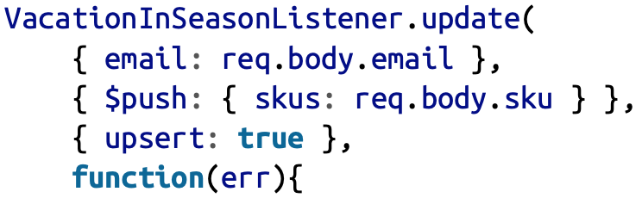
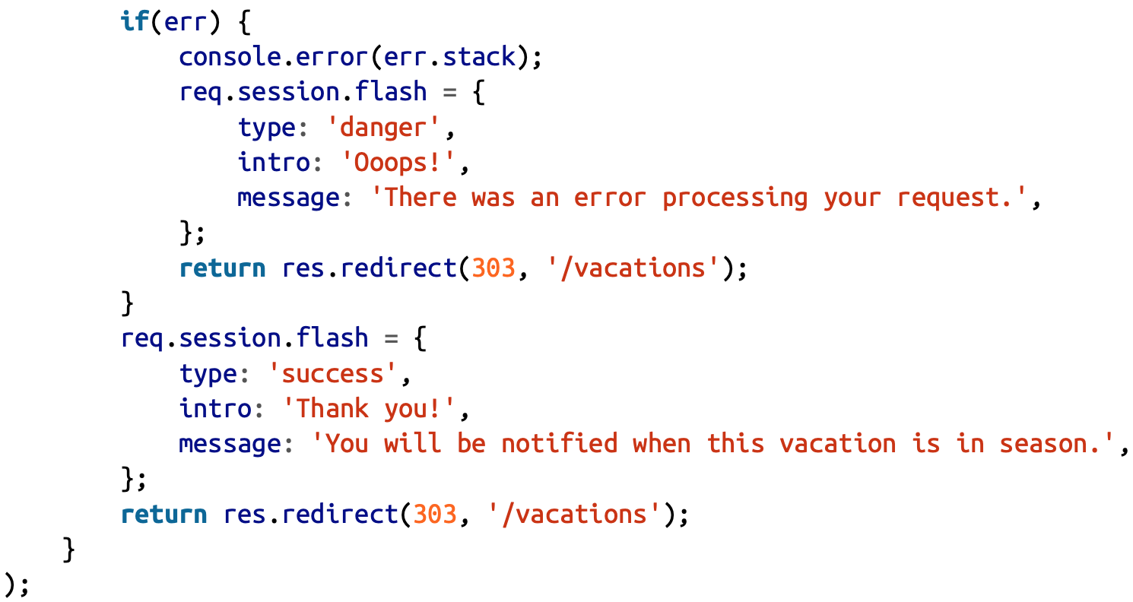
Updating Data
In route handler we can call update() like:

Slide 39
Exercise
Define student models and add some student data

Slide 40
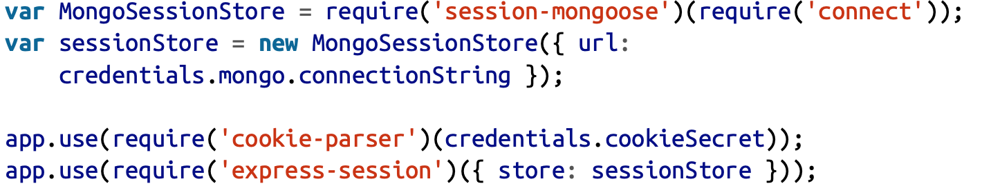
Using MongoDB for Session Storage
We’ll be using a package called session-mongoose (npm install --save session-mongoose)

